Slide 1
Marketing Presentation Master
Bernard Tai, Barney Tong, Kyle Yoon

Slide 2
What is A New App?
In order to take advantage of the ever-changing technological environment, we believe the best way is to ride the new wave of mobile applications as we enter the new era of mobile world.
We allow users to create their own app using three easy steps.
Buttons in the app are customized for each specific industry.
Philosophy: K.I.S.S (Keep It Simple Stupid)

Slide 3
Who Can Use A New App?
Entertainers
Restaurants
Retail
Pub / Clubs
Besides our primary targets, anyone who has a fan base can use our service.

Slide 4
How It Can Benefit You
Manage clients / customers / fans more effectively.
It is free and simple to use.
With the extra charge, you can receive our analytics report that can be used for your marketing and CRM services

Slide 5
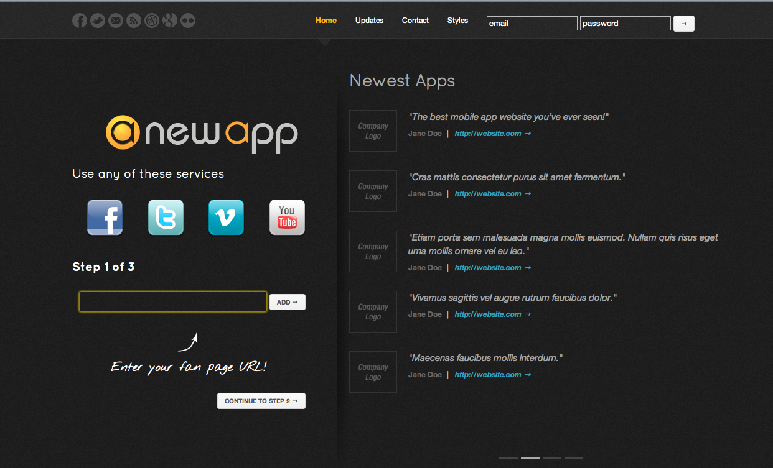
How to Have an App from Your Company?
1. Enter Existing 3rd Party Services

Slide 6
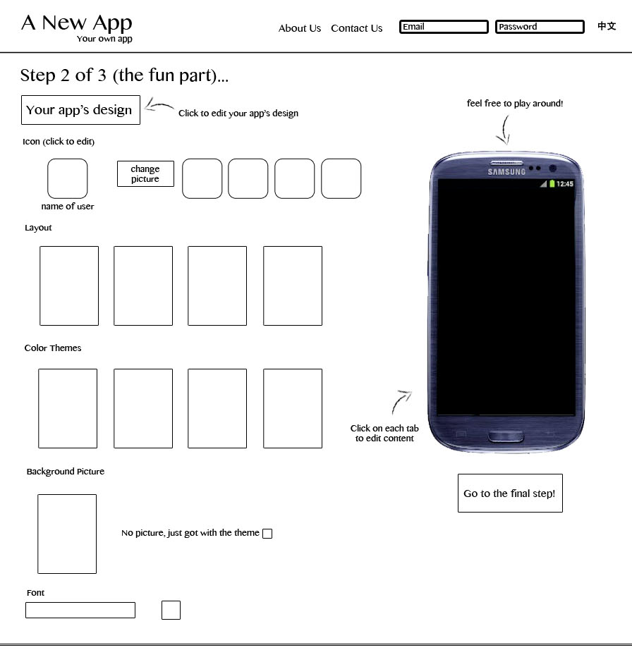
How to Have an App from Your Company?
2a. Customize App

Slide 7
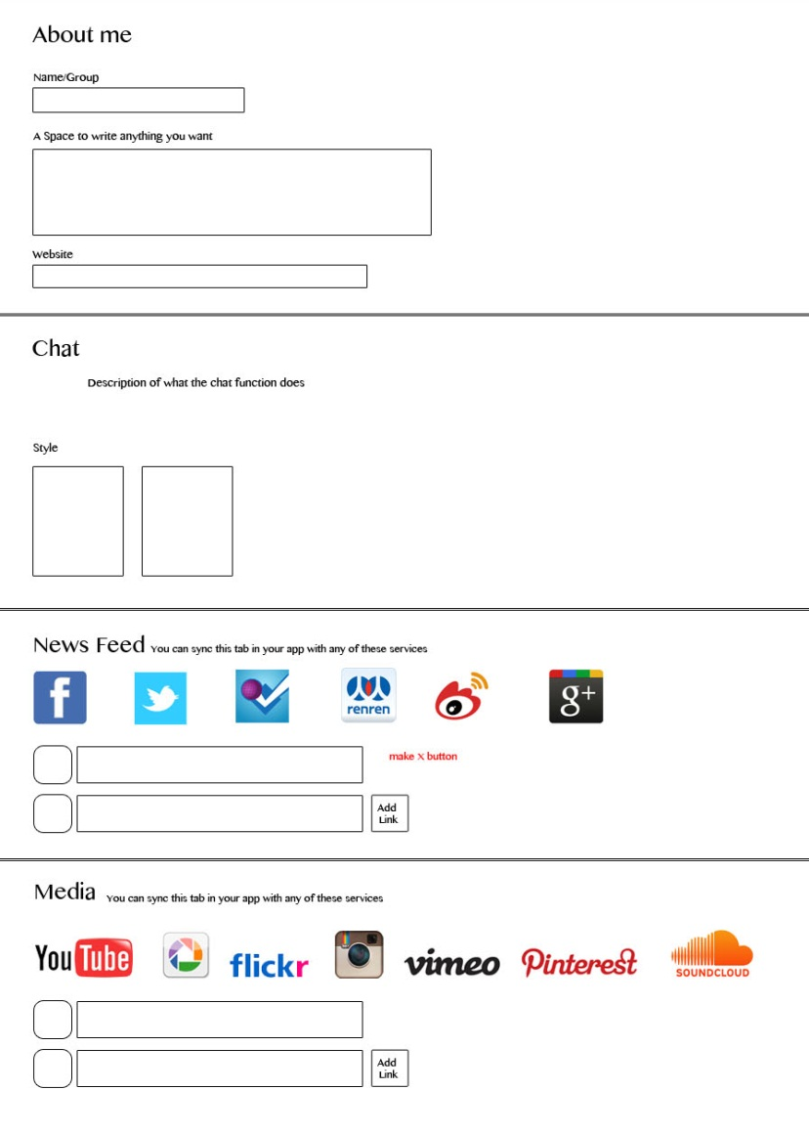
How to Have an App from Your Company?
2b. Customize App

Slide 8
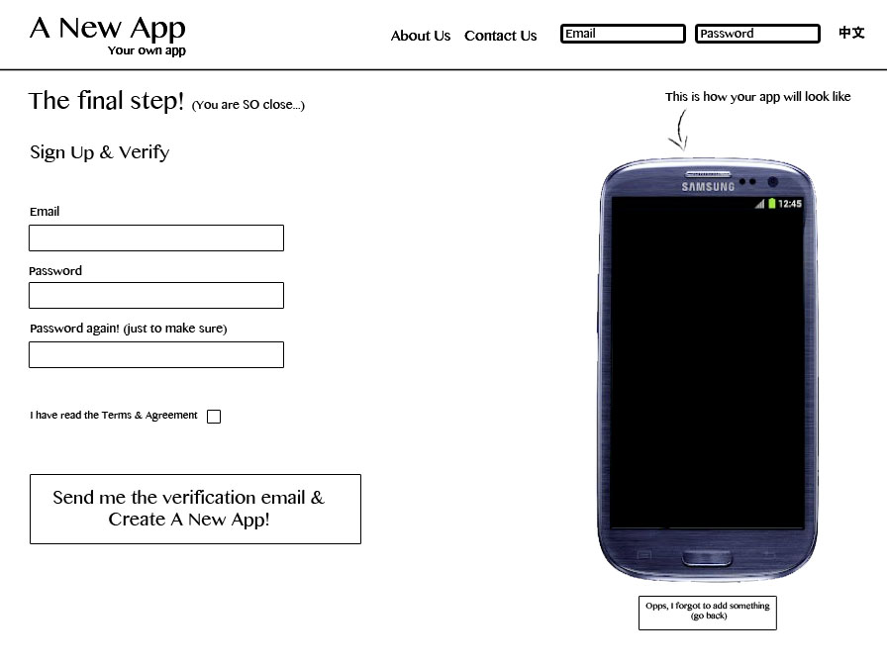
How to Have an App from Your Company?
3. Register

